Slide 1
Code Scanning and Remediation for Shell Script

Slide 2

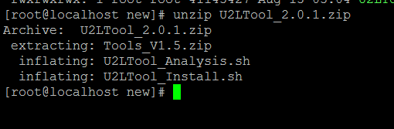

Slide 3
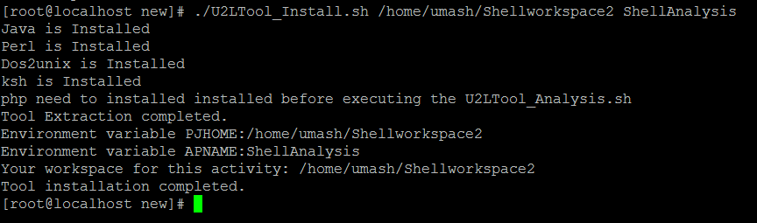
Tool Installation

Slide 4
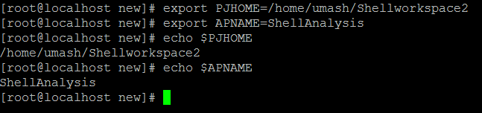
Set Environment variables

Slide 5
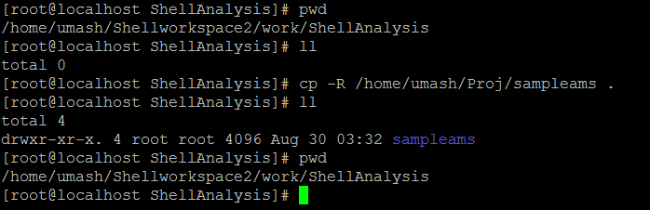
Copy The Source Code to Workspace

Slide 6
Run the tool

Slide 7
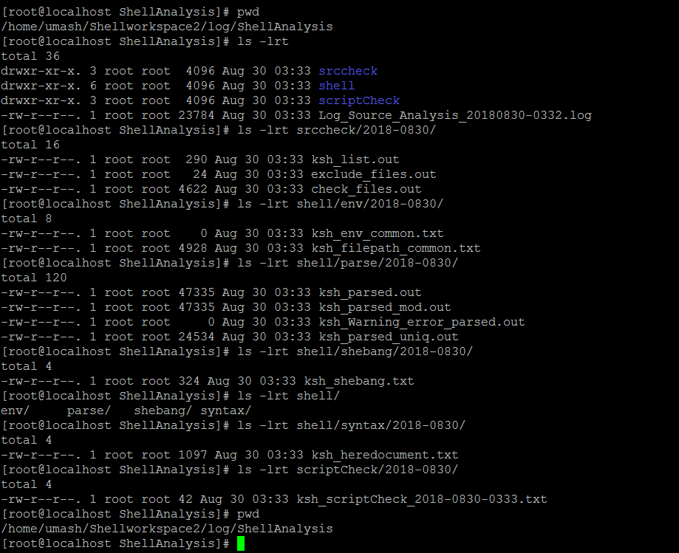
Log Directory

